Slide 1
Chapter 1 Search
By:Umer Farooq

Slide 2
What is search?
try to find something by looking or otherwise seeking carefully and thoroughly.
An internet search, otherwise known as a search query, is an entry into a search engine that yields both paid and organic results. The paid results are the ads that appear at the top and the bottom of the page, and they are marked accordingly. ... At the core of an internet search is a keyword.

Slide 3
How many search engines are there
140+ Search Engines
Meet the 7 Most Popular Search Engines in the World
Google.
YouTube.
Amazon.
Facebook.
Microsoft Bing.
Baidu.
Yandex.

Slide 4
What is Google
Google is an American company that is most commonly known as a search engine. Although the company made it's name as a search engine, and the vast majority of its income comes from advertising because of this, it has branched out into a number of areas such as cloud computing, software and hardware

Slide 5
History Of Google
Google was officially launched in 1998 by Larry Page and Sergey Brin to market Google Search, which has become the most used web-based search engine. Larry Page and Sergey Brin, students at Stanford University in California, developed a search algorithm at first known as "BackRub" in 1996, with the help of Scott Hassan and Alan Steremberg. The search engine soon proved successful and the expanding company moved several times, finally settling at Mountain View in 2003. This marked a phase of rapid growth, with the company making its initial public offering in 2004 and quickly becoming one of the world's largest media companies. The company launched Google News in 2002, Gmail in 2004, Google Maps in 2005, Google Chrome in 2008, and the social network known as Google+ in 2011 (which was shut down in April 2019), in addition to many other products. In 2015, Google became the main subsidiary of the holding company Alphabet Inc.

Slide 6
how google search works
Google search works in essentially three stages: Crawling: Google searches the web with automated programs called crawlers, looking for pages that are new or updated. ... Indexing: Google visits the pages that it has learned about by crawling, and tries to analyze what each page is about.

Slide 7
How google search
Analyze the word
Match your search
Rank useful pages
Return the best result

Slide 8
What is SEO
Search engine optimization (SEO) is the process of optimizing your online content so that a search engine likes to show it as a top result for searches of a certain keyword. ... When it comes to SEO, there's you, the search engine, and the searcher.

Slide 9
what are seo ranking factors
The term “Ranking Factors” describes the criteria applied by search engines when evaluating web pages in order to compile the rankings of their search results.
There are 200+ factors by which google decide to judge page ranked
Title
Information
Links
Loading
Responsive
Secure

Slide 10
On page optimization vs off page optimization
On Page | Off page
Keyword in the title tag. The title meta tag is one of the strongest relevancy signals for a search engine. ... Keyword in meta description tag. ... Keyword in H1 tag. ... Using keywords in the pages copy. ... The length of the content. ... Duplicate content. ... Canonical tag. ... Image Optimization. | A Secure and Accessible Website. Page Speed (Including Mobile Page Speed) Mobile Friendliness. Domain Age, URL, and Authority. Optimized Content. Technical SEO. User Experience (RankBrain) Links.

Slide 11
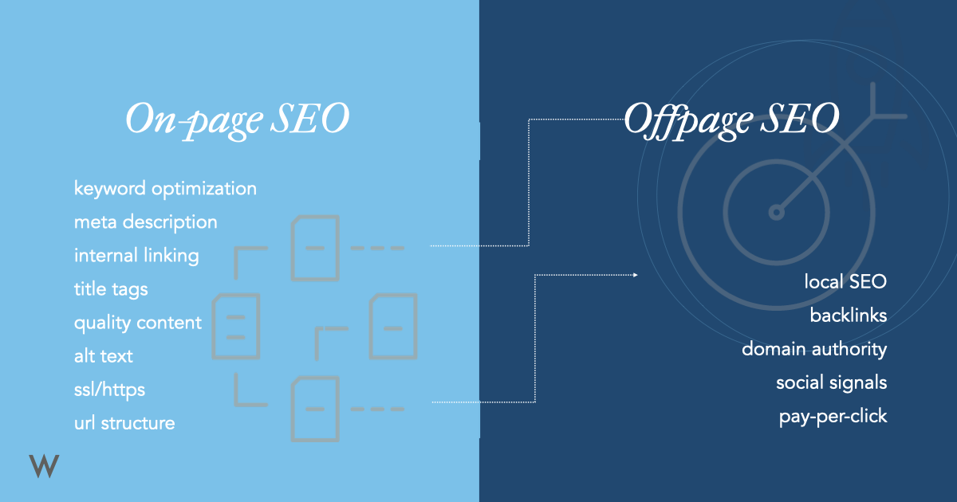

Slide 12
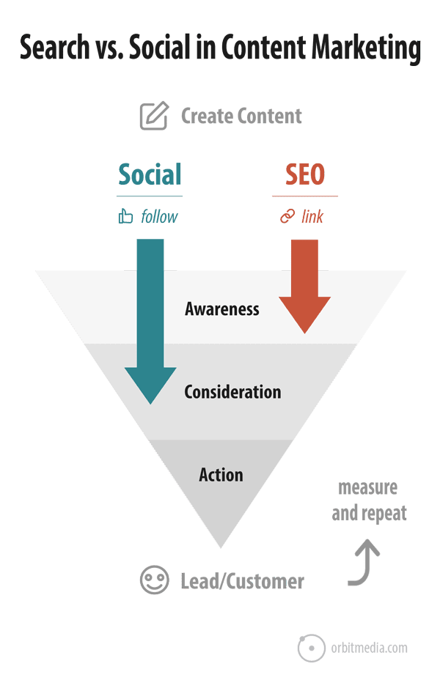
SEO is about being discovered and getting traffic through search engine rankings. It fills the top of the funnel and creates awareness.
What is social media marketing? Social media is about connecting, building relationships and getting traffic from social media networks. It strengthens the middle of the funnel and creates engagement.

Slide 13
White Hat vs. Grey Hat vs. Black Hat SEO
What Is White Hat SEO?
White hat SEO means following the “rules”. Simply, you use only ethical tactics and follow search engine guidelines.
Make good website, optimize website
What Is Black Hat SEO?
Black hat SEO means using risky practices. You use tactics that can (and, let’s be honest, do) work. Until they don’t. These range from using tactics that go against guidelines from search engines to more dangerous activities (which can lead to manual actions).
Breaking website algorithm to rank website
What Is Gray Hat SEO?
As with a lot of SEO, there are differing opinions on what gray hat SEO is.
Take the first page of Google’s results on “what is gray hat SEO” and you’ll see articles with a mixture of definitions, broadly falling into the categories of:
It’s a mixture of white hat and black hat techniques.

Slide 14
Organic SEO vs. SEM
The main difference between SEM vs. SEO is that SEM is a paid strategy and SEO is an organic strategy. Like most things in the search industry, the definitions related to search marketing have evolved . Some marketers may consider SEM to be an umbrella term that includes both paid and organic strategies.

Slide 15
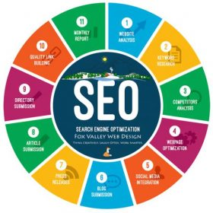
How is SEO Profession Different than Development and Design
If you think so that SEO will work only, then it is not possible. Because we have discussed earlier and you know that there are different factors involves in SEO to whom we called SEO ranking factors.

Slide 16
SEO Factors
Digital Marketing Role in SEO
Domain & Hosting Purchase
Website Design
Website Speed
Optimized Website

Slide 17
What is Content?
Content is original, actionable, and answers a question. It's properly sourced, unique, concise, grammatically correct and is formatted properly. Use this formula to craft content that will increase likes, shares, and will rank well on major search engines
Text
Image
Video
Audio

Slide 18
What is Google's Mission?
Our company mission is to organize the world's information and make it universally accessible and useful. That's why Search makes it easy to discover a broad range of information from a wide variety of sources.

Slide 19
Difference between a Search Engine & an Answer Engine?
Search engine use for only searching
But answer engine answers the question
Google is a answer engine because of its google assistant (partially)

